Slide 1
Motorola MC9S08GB

Slide 2
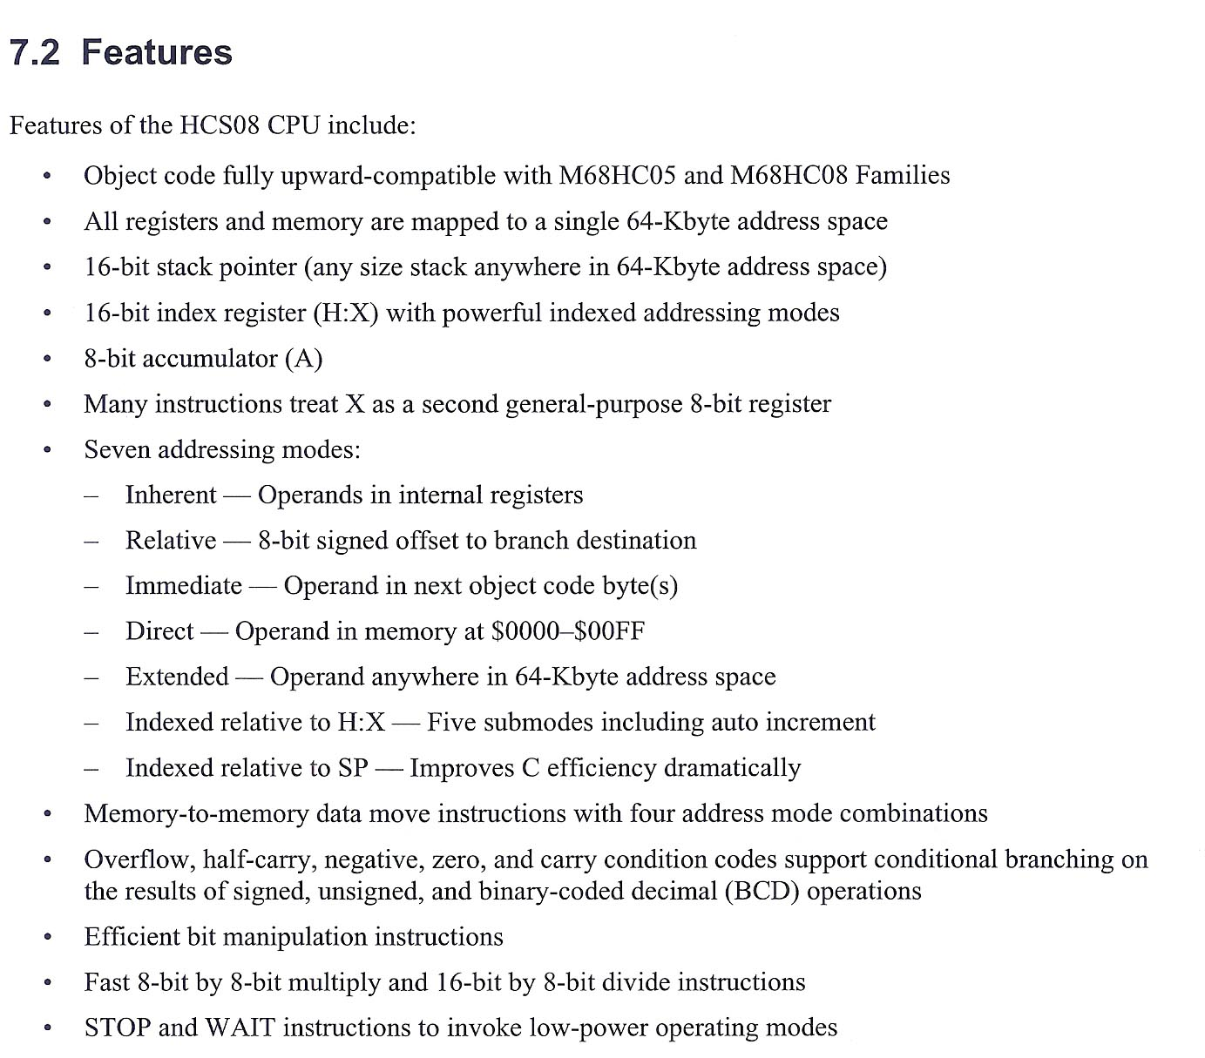
908 Features

Slide 3
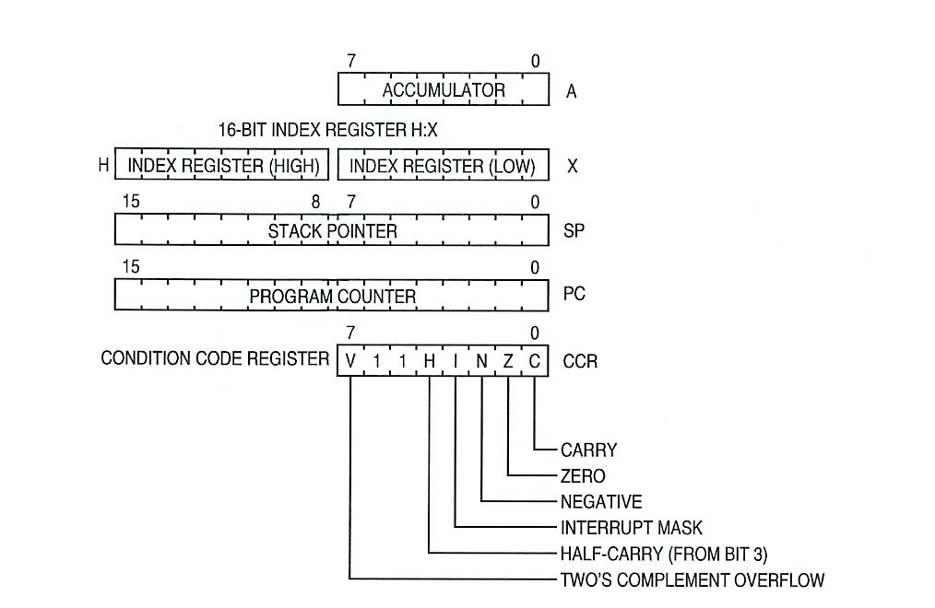
908 Register Set

Slide 4
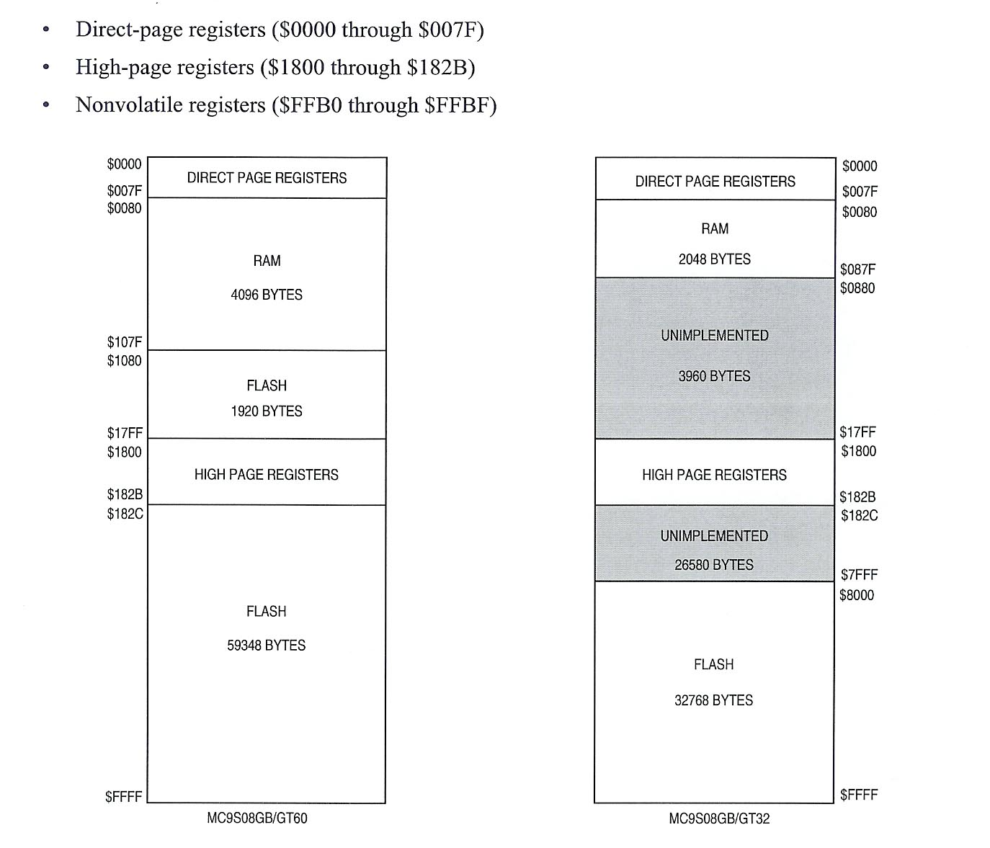
908 Memory Map

Slide 5
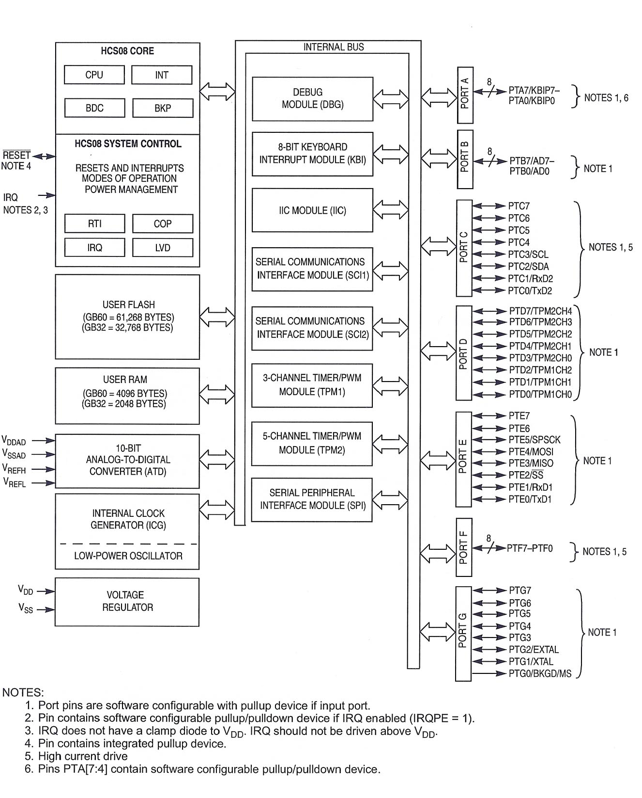
908 Block Diagram

